Slide 1


Lecture 4: ETL Part 2
Ali Chelli
Course: Business Intelligence and Data Warehousing (BID3000)

Slide 2
Pentaho Basic Functionalities

Slide 3
Some Basic Pentaho Functionalities
Select Values
Stream Lookup
Calculator

Slide 4
Select Values

Slide 5
Select Values
The "Select Values" step in Pentaho allows you to specify which fields you want to keep, remove, or rename in the data stream.
This step is extremely useful when you want to shape your data by:
removing unnecessary columns,
renaming columns to something more meaningful,
or changing the data types and formats of existing columns
you can also reorder the columns in the output data stream.

Slide 6
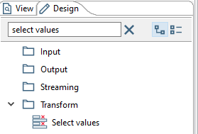
Select Values
The "Select Values" step in Pentaho can be found under Transform.
Under Design, write “select values” in the search area.
Then you can drag and drop the Select values step to the transformation.
Double click on Select values to edit this step

Slide 7
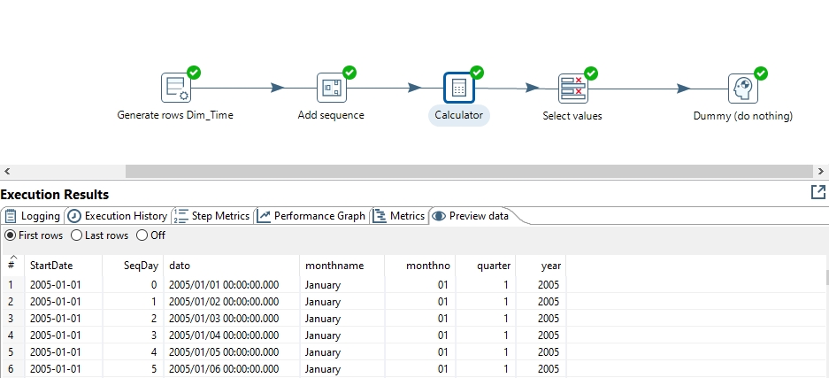
Example

Slide 8
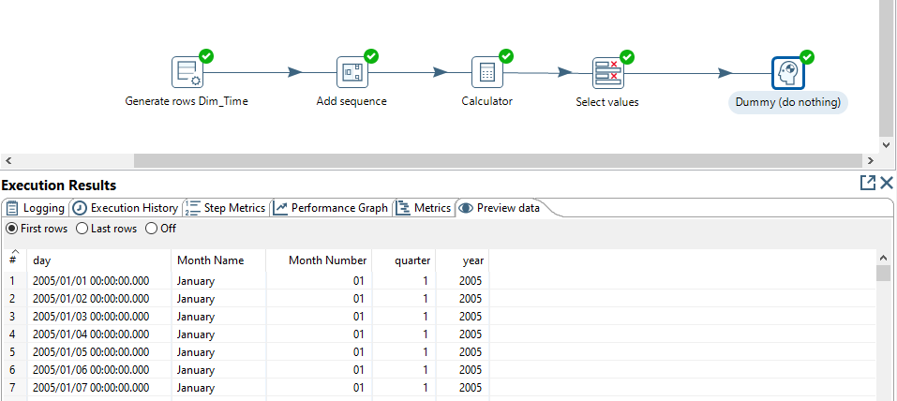
Example

Slide 9
Example
How should we configure Select values to obtain the result in the slide above?

Slide 10
Example
Select & Alter tab:
Includes all fields by clicking get fields to select
Rename to column should contain the new name for the field you want to rename
Remove tab:
Should contain the fields name of the fields that must be removed
Meta-data tab:
This tab is used to change the data type or format of the fields.

Slide 11
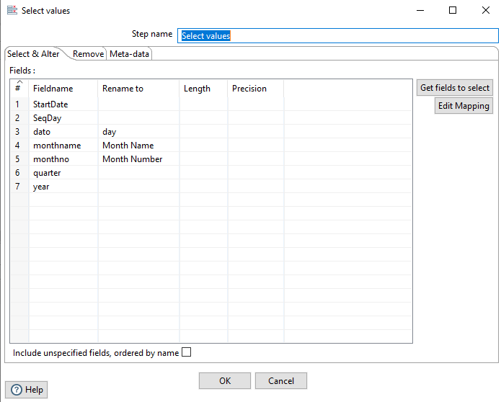
Example

Slide 12
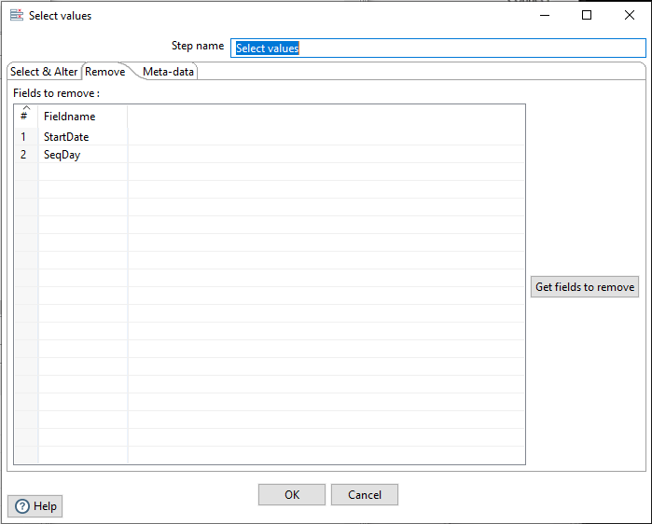
Example

Slide 13
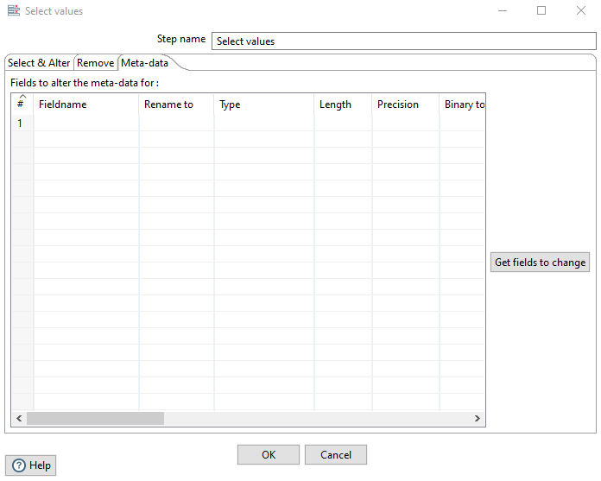
Example

Slide 14
Stream Lookup

Slide 15
Stream Lookup
Stream lookup is a transformation step in Pentaho.
It's used to enrich or look up data in a main data stream using a reference data stream.
Essentially, you have two streams of data:
one is the primary stream you are manipulating,
and the other is a lookup stream that provides additional data.
You can think of it as a kind of JOIN operation in SQL, but it's executed within the Pentaho environment.

Slide 16
How Stream Lookup Works
Loading:
The lookup stream is loaded entirely into memory.
This makes the lookup operation very fast but also means that this step can consume a lot of memory if the lookup data set is large.
Keys:
You define key fields to match between the main stream and the lookup stream.

Slide 17
How Stream Lookup Works
Data Retrieval:
For each row in the main stream, Pentaho will look for a matching row in the lookup stream based on the keys.
If a match is found, additional columns from the lookup stream can be added to the main stream.
Output:
The main stream is then output with the additional columns

Slide 18
Example
Let's consider a simple example where you have sales transaction data in one stream and customer information in another stream.
Sales Data Stream (Main Stream)
Transaction ID
Customer ID
Sales Amount
Customer Info Stream (Lookup Stream)
Customer ID
Customer Name
Customer Email

Slide 19
Example
Let's consider a simple example where you have sales transaction data in one stream and customer information in another stream.
Sales Data Stream (Main Stream)
Transaction ID
Customer ID
Sales Amount
Customer Info Stream (Lookup Stream)
Customer ID
Customer Name
Customer Email

Slide 20
Example
You want to enrich the Sales Data Stream with customer names and emails.
Steps:
Read Sales Data: Use a Data Grid step to insert and read your main Sales Data Stream.
Read Customer Info: Use another Data Grid step to insert and read your Customer Info Stream. This will serve as your lookup stream.
Stream Lookup: Add a "Stream lookup" step and connect both the above steps to this one.
Main Stream: Connect the Sales Data stream to this step.
Lookup Stream: Connect the Customer Info stream to this step.

Slide 21
Example
Configure Stream Lookup:
Keys: Match "Customer ID" from the main stream with "Customer ID" from the lookup stream.
Fields to Retrieve: Add "Customer Name" and "Customer Email" from the lookup stream to the fields that will be added to the main stream.
Output Step: Add an output step, such as "Table Output" or "CSV Output," to write the enriched data.
Now, your main Sales Data Stream will also have the "Customer Name" and "Customer Email" for each transaction, fetched from the lookup stream.
Remember that because the lookup stream is loaded into memory, this method can be very fast for moderate sizes of lookup data but can consume a lot of memory if the lookup stream is very large.

Slide 22
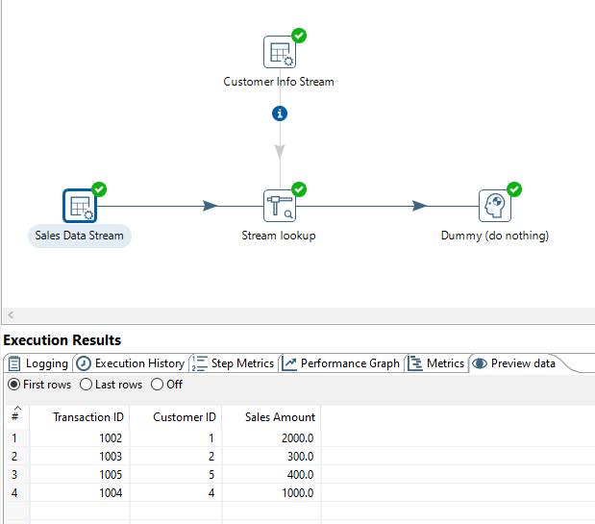
Example

Slide 23
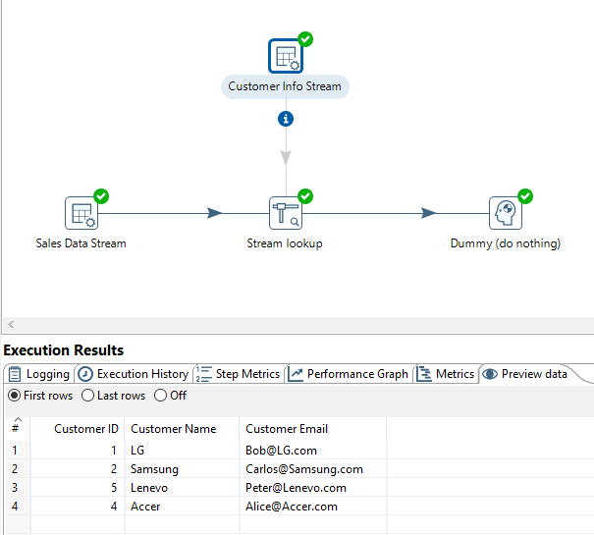
Example

Slide 24
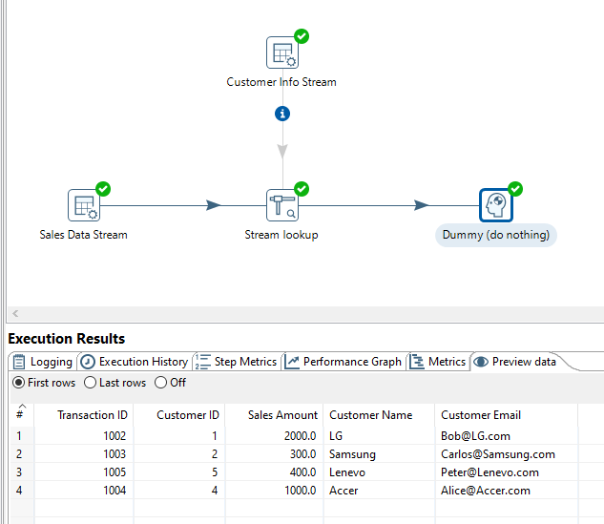
Example

Slide 25
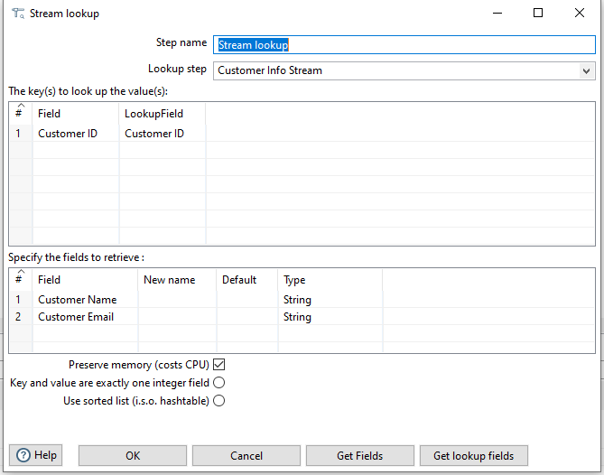
Example

Slide 26
Calculator

Slide 27
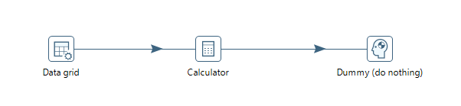
Task
Use the structure of the transformation shown below
Insert the necessary data in the data grid
configure the calculator (see next slide) and preview the results of each step

Slide 28
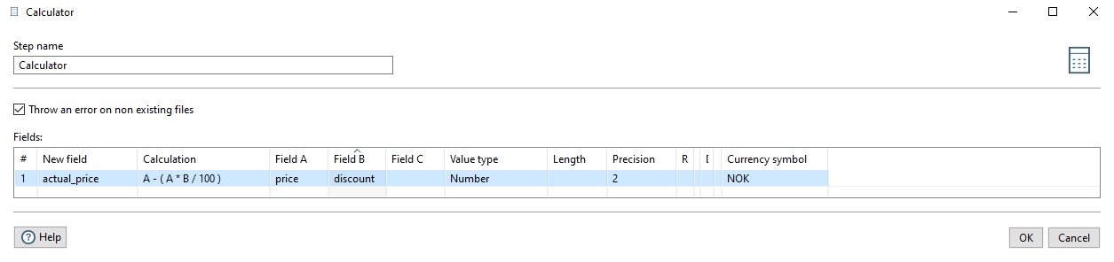
Task

Slide 29
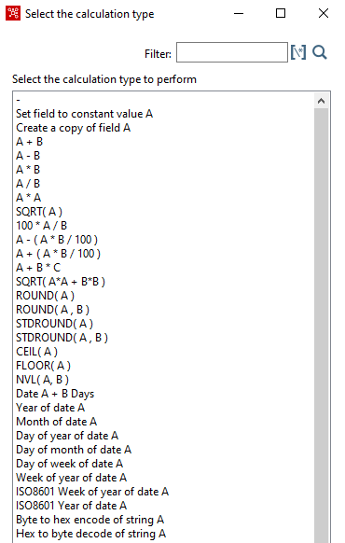
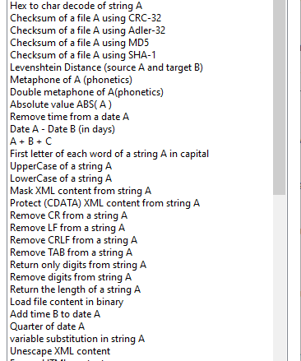
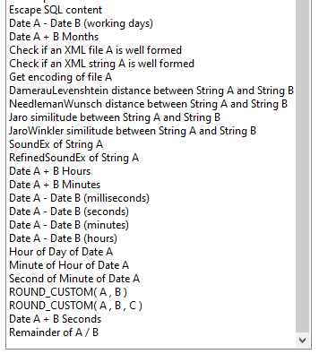
Explore Calculator

Slide 30
Assignment

Slide 31
Objective: Building coffeemerchant Data Warehouse Using Spoon PDI
SQL-script
CoffeeMerchant
database
CoffeeMerchant
Datawarehouse
Power BI
Spoon
ETL

Slide 32
Creating the Data Warehouse Using Spoon
Spoon Transformation
dim_time
consumers
dim_customer
inventory
dim_inventory
orders
Staging-tabell
fact_sales
orderLines

Slide 33
Assignment Solution

Slide 34
Creating Dim_Time Table

Slide 35
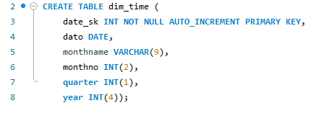
Create a Time Dimension Table Using Spoon
First create a data warehouse called coffeemerchant_Spoon_dw2
CREATE DATABASE coffeemerchant_Spoon_dw2;
The fields in the dim_time table are: date_sk (Auto Increment Primary Key), dato DATE, monthName String (9), monthno Integer(2), quarter integer(1), year integer(4).
The start date: 2005-01-01
The end date: 2006-12-31

Slide 36
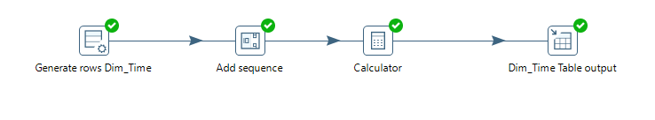
Modelling transformations with PDI:
We start with filling up the time dimension
This is modelled this way in PDI:

Slide 37
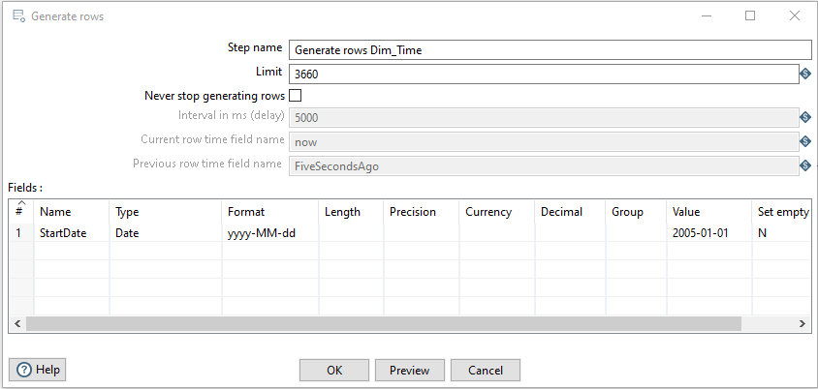
Generating Dates:
We start with Generate Rows (Input | Generate Rows):

Slide 38
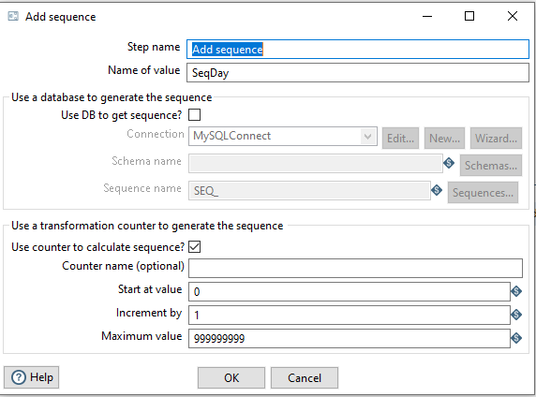
Define Sequence
We define the sequence (Transform | Add sequence):

Slide 39
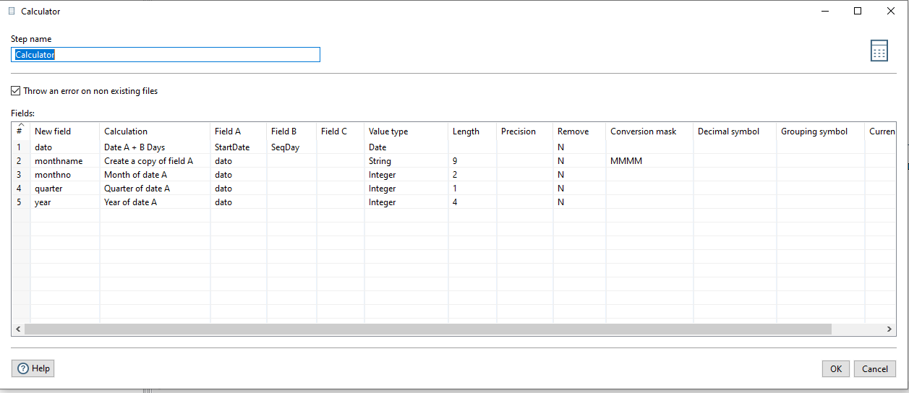
Calculator
Setting up calculations in Calculator (Transform | Calculator):

Slide 40
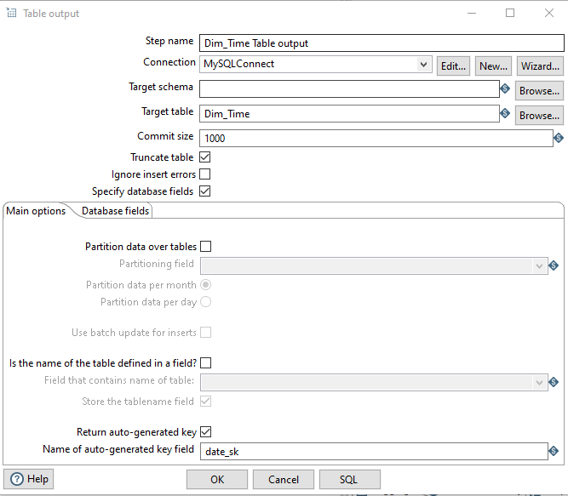
Table Output

Slide 41
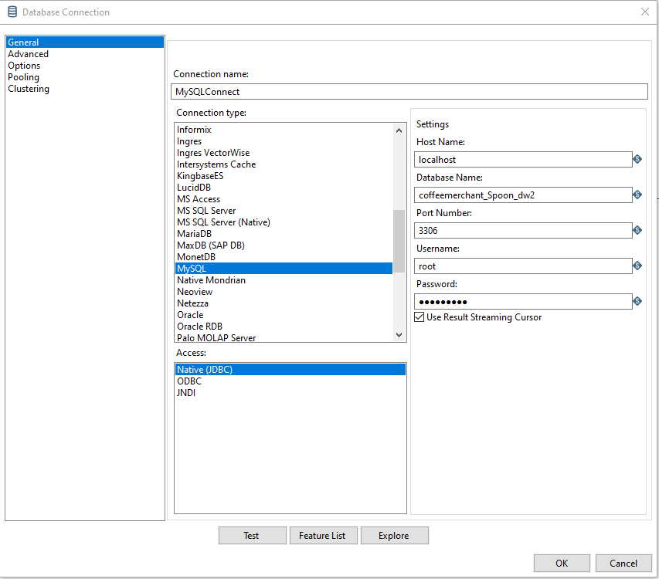
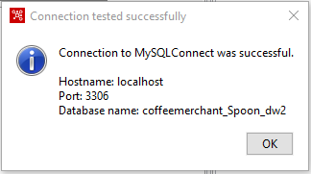
Creating DB Connection

Slide 42
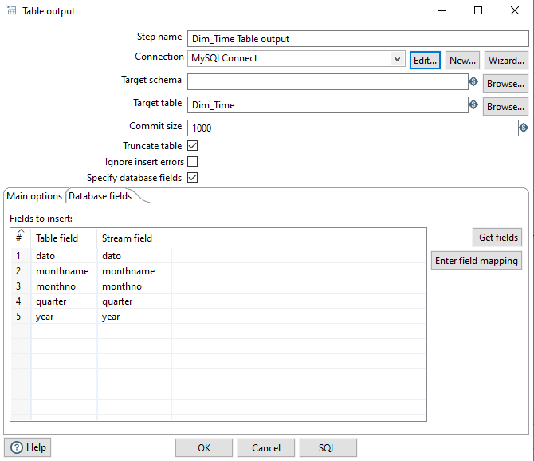
Table Output
Notes:
If you need to move the position of a field:
Right click on the field then chose move up (shortcut: ctrl-up)
Right click on the field then chose move down (shortcut: ctrl-down)

Slide 43
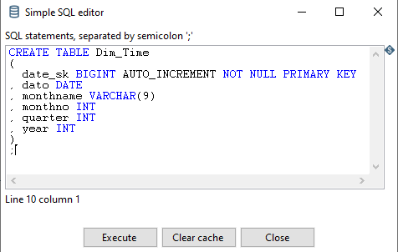
SQL code

Slide 44
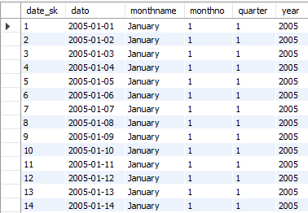
Generating dates:
Loading the table dim_time:

Slide 45
Creating the Data Warehouse Using Spoon
Spoon Transformation
dim_time
consumers
dim_customer
inventory
dim_inventory
orders
Staging-tabell
fact_sales
orderLines

Slide 46
Creating Dim_customer

Slide 47
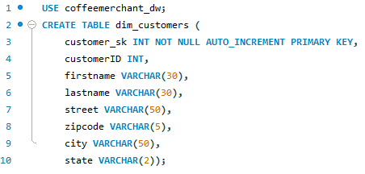
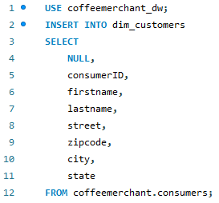
Reminder dim_customers:
Creating the table:
Filling the table from the source database :

Slide 48
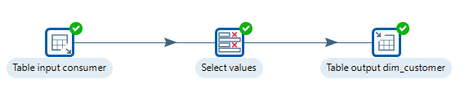
Modelling The Transformation with Spoon

Slide 49
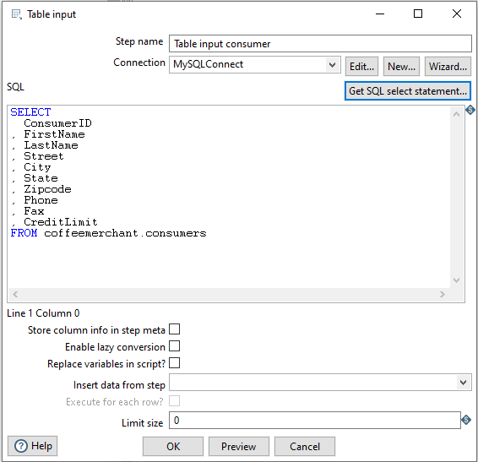
Input Table SQL code

Slide 50
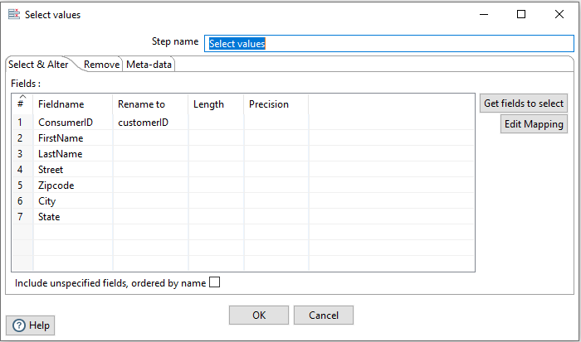
Transform | Select Value

Slide 51
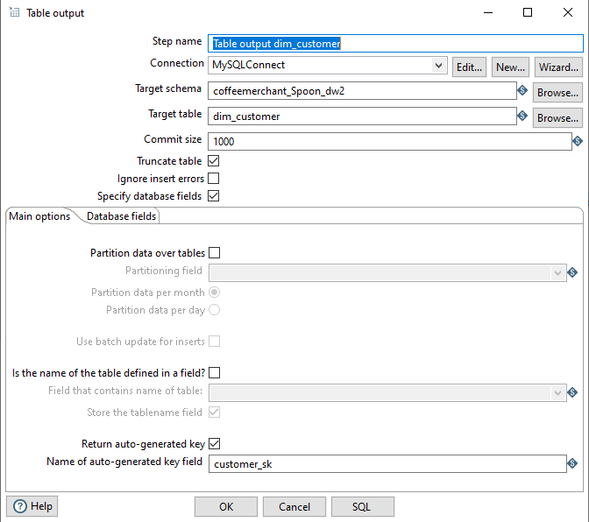
Output Table

Slide 52
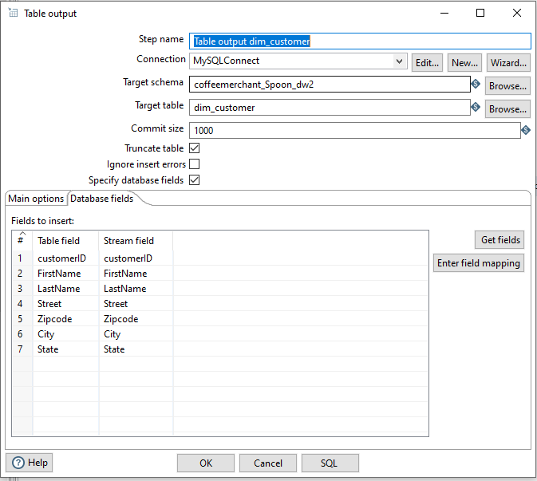
Output Table

Slide 53
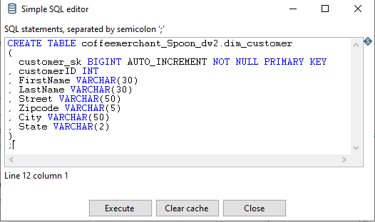
Output Table SQL code

Slide 54
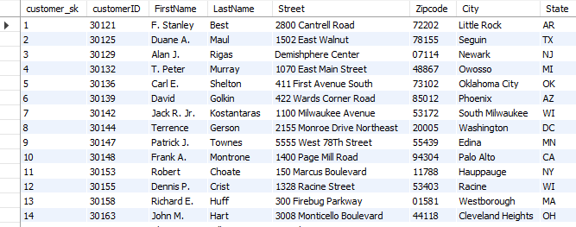
Loading the Table dim_customer

Slide 55
Creating the Data Warehouse Using Spoon
Spoon Transformation
dim_time
consumers
dim_customer
inventory
dim_inventory
orders
Staging-tabell
fact_sales
orderLines

Slide 56
Creating Dim_inventory

Slide 57
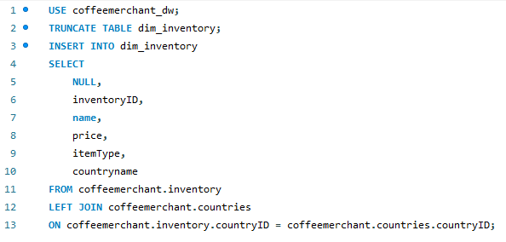
Reminder: Creating and Filling dim_inventory with SQL
Creating the table:
Filling the table from the source database:

Slide 58
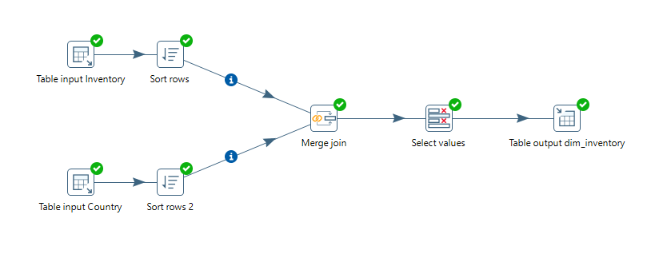
Filling up dim_inventory
Demands a Join between the Inventory and the Country tables in the source system:

Slide 59
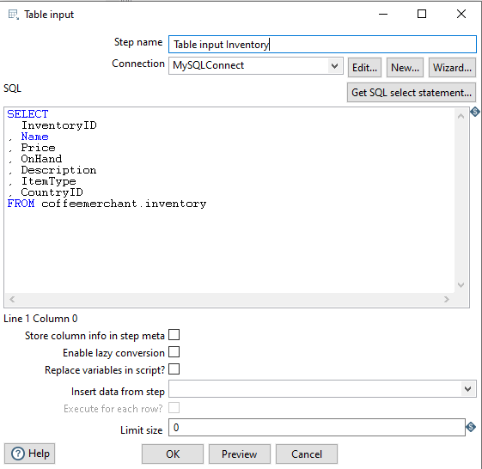
Input Table Inventory

Slide 60
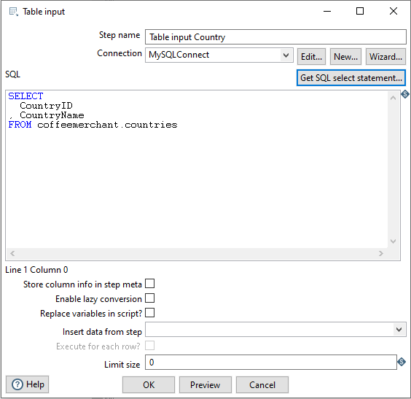
Input Table Country

Slide 61
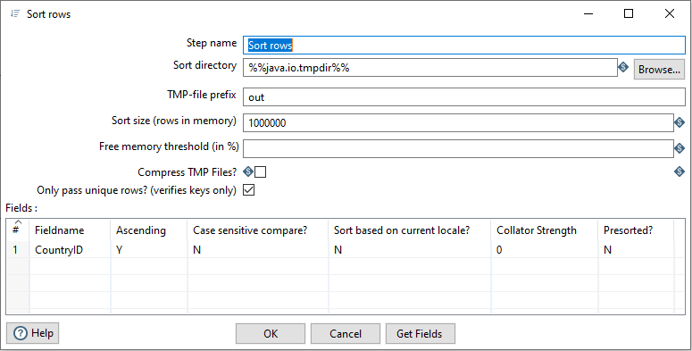
Sorting Inventory by CoutryID
Step 1: Sorting inventory input:

Slide 62
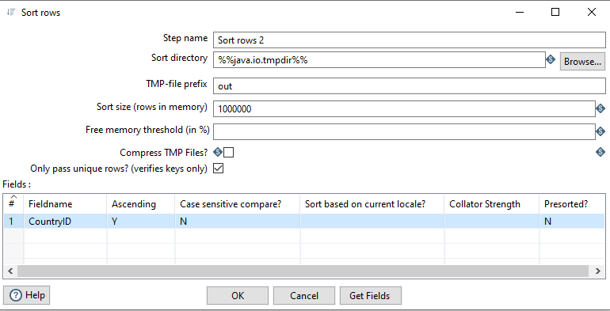
Sorting Rows in Country by CoutryID

Slide 63
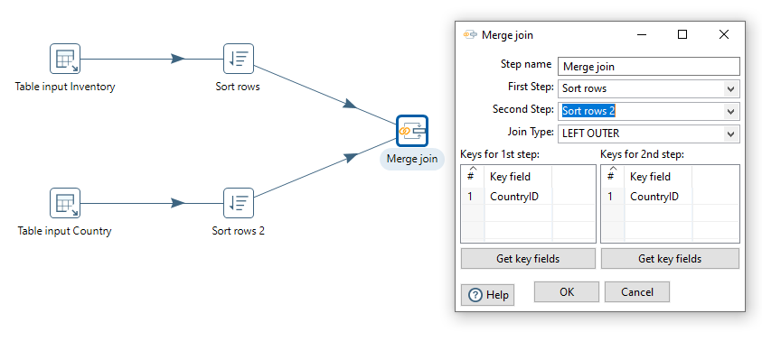
Left Outer Join of Inventory and Country Tables

Slide 64
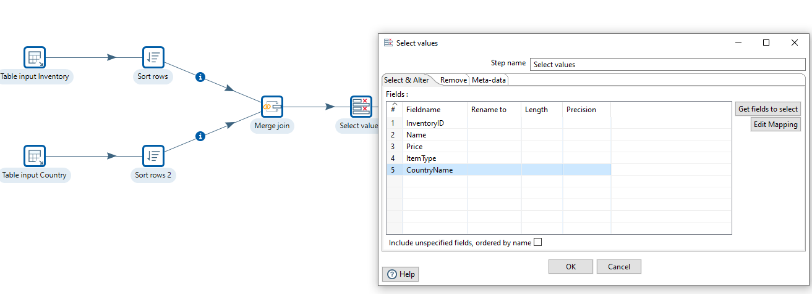
Select Values

Slide 65
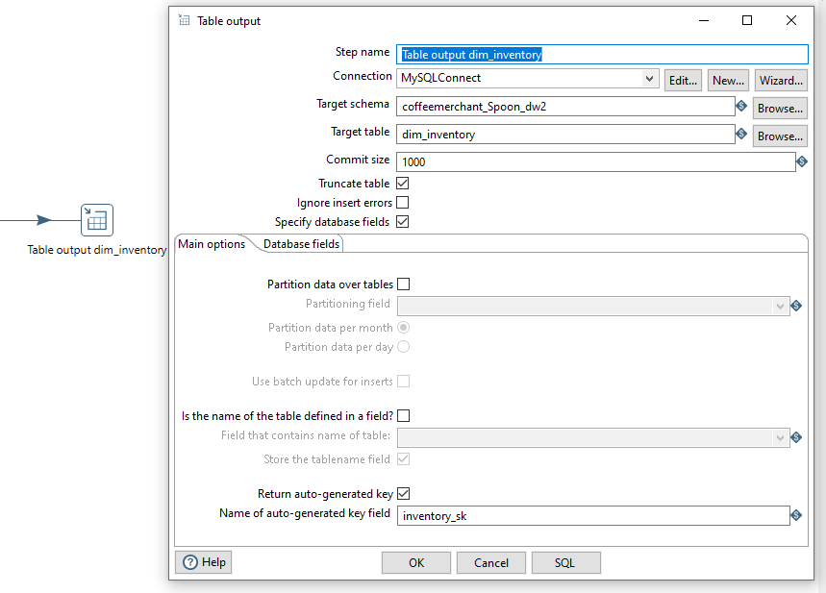
Dim_inventory Table

Slide 66
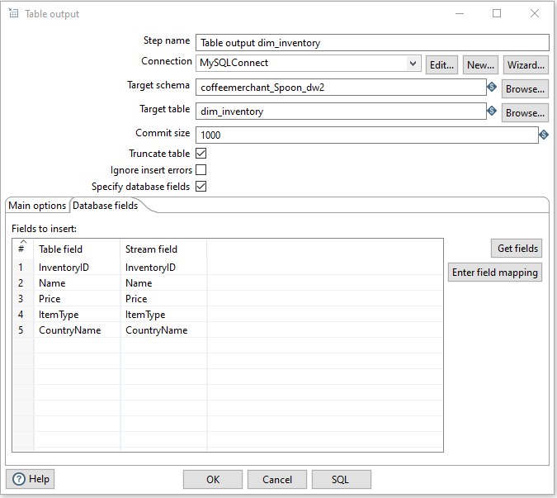
Dim_inventory Table

Slide 67
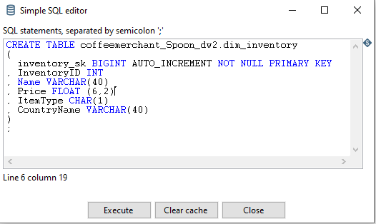
Dim_inventory Table: SQL Code

Slide 68
Filling up dim_inventory Using Spoon

Slide 69
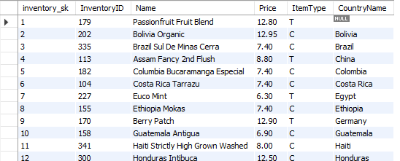
Loading the Table dim_inventory

Slide 70
Creating the Data Warehouse Using Spoon
Spoon Transformation
dim_time
consumers
dim_customer
inventory
dim_inventory
orders
Staging-tabell
fact_sales
orderLines

Slide 71
Creating Staging Table: Fact_stage_order

Slide 72
Reminder: SQL Way

Slide 73
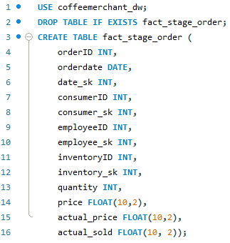
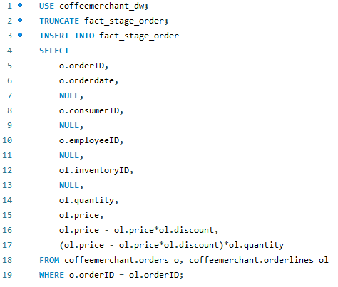
A staging table for facts:
Creating the fact staging table:
Filling the table from the source database:

Slide 74


Adding Surrogate Keys to the Staging Table:

Slide 75
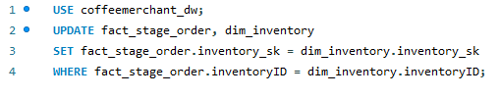

Adding Surrogate Keys to the Staging Table:

Slide 76

Creating the fact sales table:

Slide 77

Loading Data From staging table to fact table:

Slide 78
Spoon Way

Slide 79

Creating Fact_stage_order Using Spoon

Slide 80

Transformation fact_sales Table

Slide 81
Explanation of the model:
Data are read from the same sources as before, with the same SQL JOIN statement.
Before a Stream Lookup the data must be sorted on the field(s) that will be used for lookup. In this case, the date.
A Stream Lookup retrieves the surrogate key from the time dimension.
The data are sorted again, this time on customerID.
A new Stream Lookup retrieves the customer surrogate key from dim_customer.
New sort, this time on inventoryID.
A new Stream Lookup retrieves the inventory surrogate key from dim_inventory.
New sort on employeeID.
A Stream lookup retrieves the employee surrogate key.
A Calculator calculates actual_price (price minus discount).
A Calculator calculates actual_sold (actual_price*quantity).
Filtering: removing the columns that are not to be loaded to the target table.
Loading to fact_sales.

Slide 82

The table fact_sales in MySql:

Slide 83

Input:
When you know SQL, the simplest may be to write the JOIN directly:

Slide 84

Sorting on orderdate:

Slide 85


Using Stream Lookup to retrieve a surrogate key:

Slide 86

Making ready for lookup: we delete all fields not needed

Slide 87



Calculations:
Første
Utregning:
actual_price

Slide 88


Calculations:
Andre utregning:
actual_sold

